Slide 1
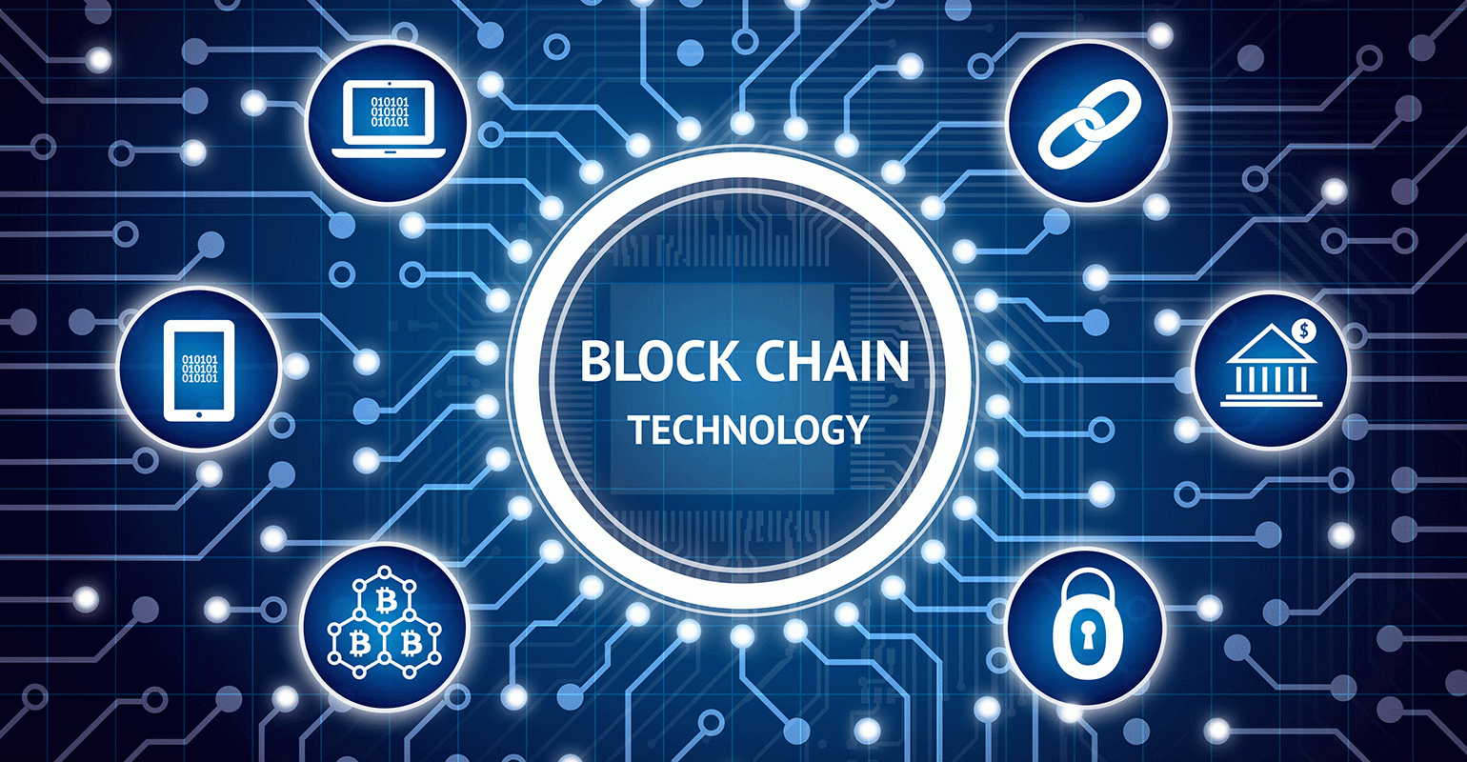

Slide 2
Abstract
What is Blockchain ?
Blockchain Basic Architecture
How Blockchain works
Pillars of Blockchain
Proof Of Work
Use Cases & Practical Implementation
Limitation Of Blockchain Technology

Slide 3
What IS BLOCKCHAIN?
In simple words, Blockchain can be defined as a chain of the block that contains information.
This technique is intended to timestamp digital documents so that it's not possible to backdate them or temper them. This technology was originally described in 1991 and was intended to timestamp digital documents to avoid backdate or tempering of any records.
The term Blockchain became popular when an anonymous person or a group of people known as Satoshi Nakamoto published a paper on the Bitcoin cryptocurrency

Slide 4
What is a Block?
“Blocks” on blockchain are made up of digital pieces of information.
Basically they have three parts:
Information according to the use case
Participants present in the transaction
A unique information to separate them from other blocks in the network
Block1
Block2
Block3
Block N
Genesis Block

Slide 5
Three Pillars OF Blockchain
Decentralization
Transparency
Immutability

Slide 6
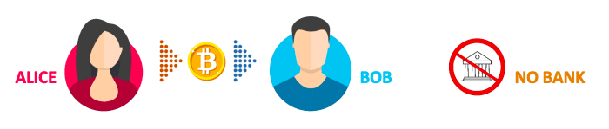
Decentralization
In a decentralized system, the information is not stored by one single entity. In fact, everyone in the network owns the information.
In a decentralized network, if you wanted to interact with your friend then you can do so directly without going through a third party

Slide 7
The New Networks
Centralized Decentralized
Central system have a core authority that dictates the truth to other participants in the network
Only privileged users or institutions can access the transaction history and confirm a new transaction
Decentralized system have no core authority that dictates the truth to other participants in the network
Every participants in the network can access the transaction history and confirm a new transaction

Slide 8
Transparency
Transparency is one of the major feature in blockchain. It is one of the most interesting and misunderstood concepts. Some people say that blockchain gives you privacy while some say that it is transparent
In any transaction that happens in a blockchain network a participant identity is hidden via complex cryptography and is represented using their public ip address.
Eg. If alice sends 1 bitcoin then you will not see “Alice sent 1 bitcoin” instead it will be like “1MF1bhsFLkBzzz9vpFYEmvwT2TbyCt7NZJ sent 1 bitcoin” in the ledger.

